Slide 1

Detection of Fraud
Transaction through Machine Learning

Slide 2
Introduction

Slide 3
Introduction
The increase in digital financial transactions has led to a greater need for advanced, AI-driven fraud detection systems.
AI and machine learning models detect fraud more quickly and accurately than conventional rule-based systems.
Many legitimate transactions are incorrectly flagged as fraudulent. This leads to customer dissatisfaction, increased manual verification, and financial losses.
AI models may disproportionately flag certain demographic groups due to biased training data.
This raises ethical concerns, harms consumer trust, and poses regulatory risks.
Historical data often lacks representation of diverse transaction behavior.
Strict and static rules often fail to consider transaction context and evolving fraud tactics.

Slide 4
Problem
statement

Slide 5
Problem statement
Financial institutions rely on AI for fraud detection but face:
High false-positive rates
Bias in detection models
1
Legitimate transactions wrongly flagged
Leads to transaction declines, customer frustration, manual review costs
2
Skewed training data causes unfair targeting of demographic groups.
Raises ethical, regulatory, and reputational risks
3

Slide 6
Research questions
How do high false-positive rates in financial transactions result from AI-driven fraud detection systems?
What elements affect AI-based fraud detection algorithms' precision and dependability?
How does bias in AI fraud detection systems result from dataset imbalance?
What tactics may be used to reduce bias and increase the accuracy of AI fraud detection systems?

Slide 7
Research objectives
To investigate the reasons behind AI-driven fraud detection systems' high false-positive rates.
To examine how bias in AI fraud detection algorithms is affected by unbalanced training datasets.
To evaluate the difficulties that false-positive fraud detection presents for operations and consumer happiness.
To provide methods for raising accuracy and lowering bias in AI-driven fraud detection systems.

Slide 8
Literature
review

Slide 9
High false positive rate
AI-driven fraud detection systems have transformed how financial institutions identify fraudulent activities by leveraging pattern recognition and predictive modeling.
However, these systems often suffer from high false-positive rates, where legitimate transactions are mistakenly flagged as fraudulent.
This issue stems from the inflexibility of detection algorithms and their inability to adapt to dynamic fraud patterns. Rule-based systems, which rely on predefined thresholds, lack the contextual understanding needed to differentiate between legitimate and fraudulent transactions, a limitation that early AI models also struggle with.

Slide 10
Bias in fraud detection
Bias in AI fraud detection models often originates from imbalanced training datasets, where fraudulent transactions are significantly underrepresented compared to legitimate ones.
This imbalance can lead to models that disproportionately flag transactions from specific demographic groups, such as those with non-traditional banking behaviors or limited transaction histories.
Historical banking practices and biased feature selection such as over-reliance on features like geographic location or transaction frequency further exacerbate this issue.
The consequences include restricted financial access for affected groups and potential regulatory violations.

Slide 11
methodology

Slide 12

methodology
Performed EDA on data to identify relevant features
Executed ML Classification Models such as isolation forest and Autoencoder
Model performed poorly on data
Implemented Random Forest for Fraud Classification

Slide 13
Data collection

Slide 14
Data analysis techniques:
Data preprocessing
Unsupervised Learning
Supervised Learning

Slide 15
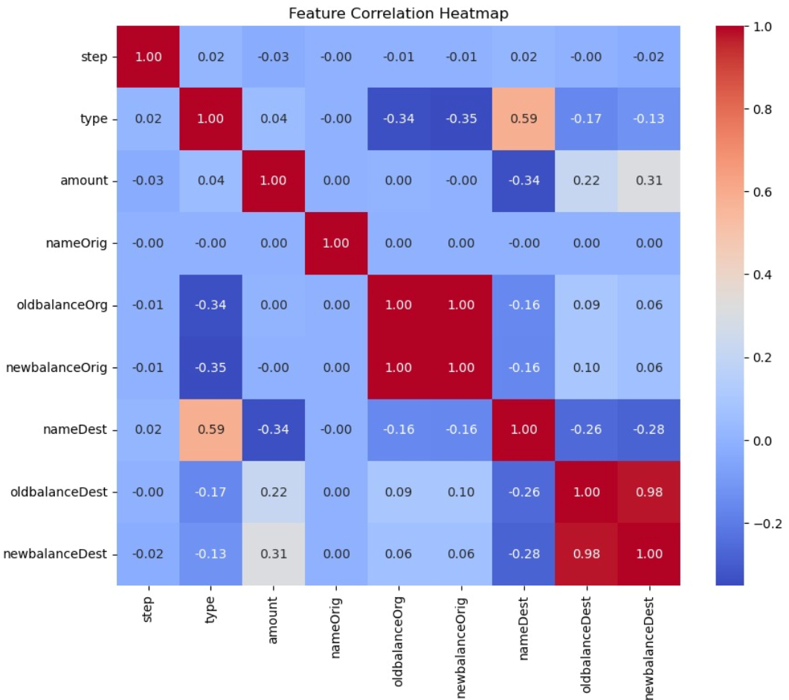
Correlation heatmap

Slide 16
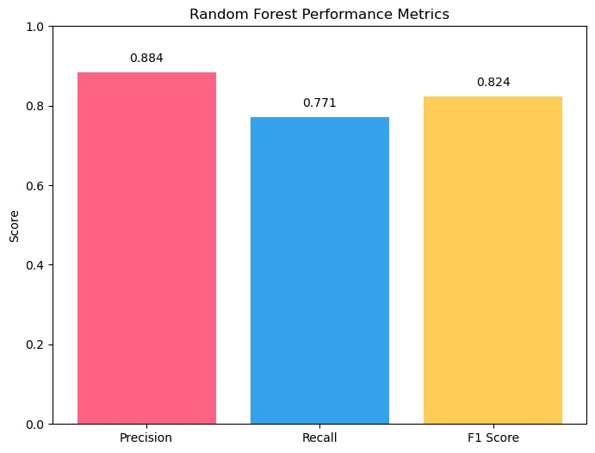
results
Model | Precision | Recall | F1 Score
Autoencoder | 0.0103 | 0.4781 | 0.0202
Isolation Forest | 0.0063 | 0.0642 | 0.0115
Random Forest | 0.8842 | 0.7706 | 0.8235

Slide 17
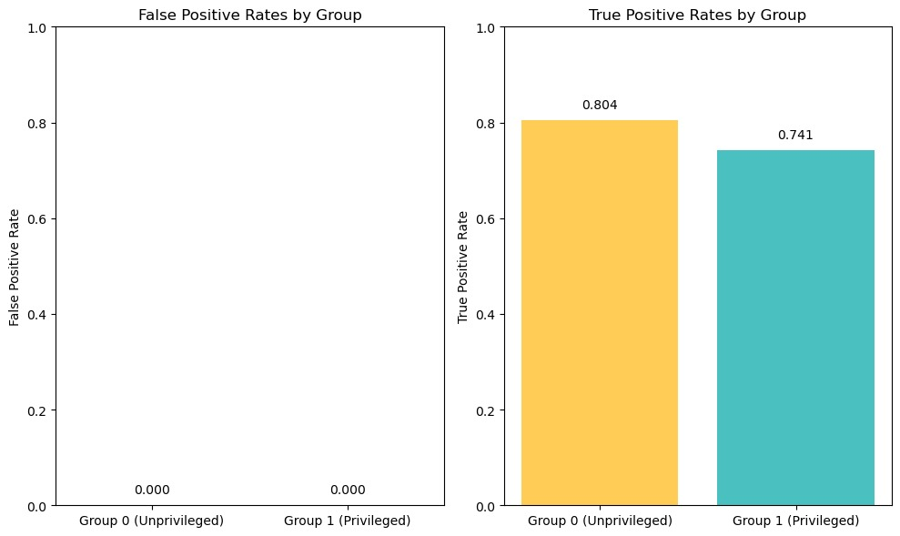
Confusion matrix
False Positive Rate:
Group 0 (Unprivileged): 0.00012175
Group 1 (Privileged): 0.00009014
True Positive Rate:
Group 0: 0.8039
Group 1: 0.7414

Slide 18
limitation
Hesitant to share data
Changing Fraud Techniques
Generalizability

Slide 19
Key findings
Effectiveness and Retraining Drive Performance
Less Predictive False Positives & Regulatory Compliance
Low Model Predictive Power

Slide 20
recommendation
Regular retraining of Models
Integration of Explainable AI Tools
Adoption of Fairness Aware Algorithms
Enhancing Regulatory Compliance through governance

Slide 21
conclusion

Slide 22
THANK YOU
Fahad Arshad (24k-7303)
Nofil Ahmed (24k-7321)

